Slide 1
MARKETING ANALYTICS I
SESSION 10:
BEHAVIORAL SEGMENTATION AND TARGETING WITH RFM ANALYSIS
Professor Sonnier
Texas MSBA Program
Fall 2022

Slide 2
SEGMENTATION
Bases for Segmentation
WHO
Who are the customers?
WHAT
What have the customers done?
WHY
Why to customers make the decisions they do?

Slide 3
SEGMENTATION
Behavioral Bases for Segmentation
Revealed Preference Data
What customers actually do
Stated Preference Data
What customers say they will do

Slide 4
SEGMENTATION
Using Behavioral Data
Rule of thumb
Based on past behavior use simple statistics (no models) to predict future behavior
Heuristics
Create models that use behavior as a source of model building
The analyst decides what behavior to model
Model Driven
Notes:
This concept actually stems from John Hagel's and Marc Singer's HBR and McK Quarterly article "Unbundling the Corporation". Their hypothesis is that decreasing interaction costs will drive corporations (or at least those intent on staying competitive) to disaggregate according to the above overall "functions".
We introduce this concept to business unit strategy to help teams focus on those functions of the client and their competitors which are most crucial on the competitive battlefield. Thus most investigative effort will be spent where it really matters. In the pyramid introduced above we give some suggestions which frameworks/tools/concepts can be helpful for further analysis depending on the driver(s) of the business.
Of course many business units will have more than one value driver. A pharmaceutical BU, for example, might very well be competing as a customer relationship business (targeting its sales force for maximum impact with physicians) as well as competing as an innovation business (developing and managing its drug pipeline). Both drivers of the business will need to be examined by the team. In the spirit of Hagel and Singer this might also be the starting point to investigate possibilities to unbundle the functions of the BU or the corporation and have the client focus on the game he's prepared to play best at.

Slide 5
SEGMENTATION
Sales Data Come in All Shapes and Sizes!
Recency
How long ago did the customer make the purchase?
How many purchases has the customer made (in given time period)
Frequency
How much has the consumers spent in total (in given time period)
Monetary
The premise of RFM is that past behavior predicts future behavior
Notes:
This concept actually stems from John Hagel's and Marc Singer's HBR and McK Quarterly article "Unbundling the Corporation". Their hypothesis is that decreasing interaction costs will drive corporations (or at least those intent on staying competitive) to disaggregate according to the above overall "functions".
We introduce this concept to business unit strategy to help teams focus on those functions of the client and their competitors which are most crucial on the competitive battlefield. Thus most investigative effort will be spent where it really matters. In the pyramid introduced above we give some suggestions which frameworks/tools/concepts can be helpful for further analysis depending on the driver(s) of the business.
Of course many business units will have more than one value driver. A pharmaceutical BU, for example, might very well be competing as a customer relationship business (targeting its sales force for maximum impact with physicians) as well as competing as an innovation business (developing and managing its drug pipeline). Both drivers of the business will need to be examined by the team. In the spirit of Hagel and Singer this might also be the starting point to investigate possibilities to unbundle the functions of the BU or the corporation and have the client focus on the game he's prepared to play best at.

Slide 6
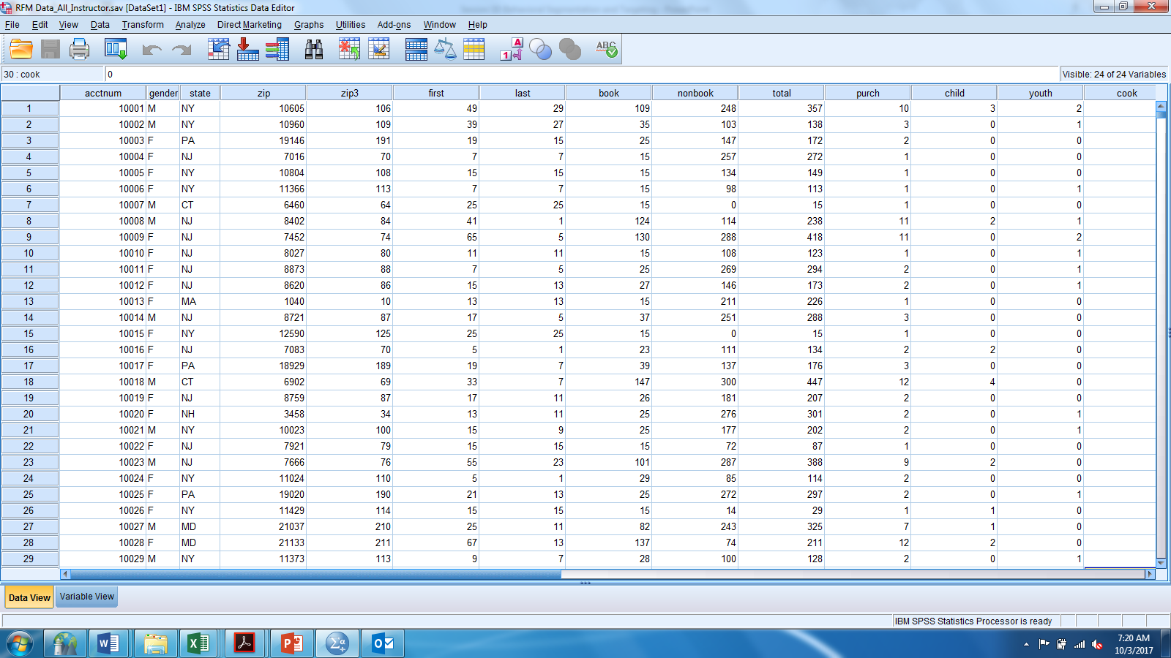
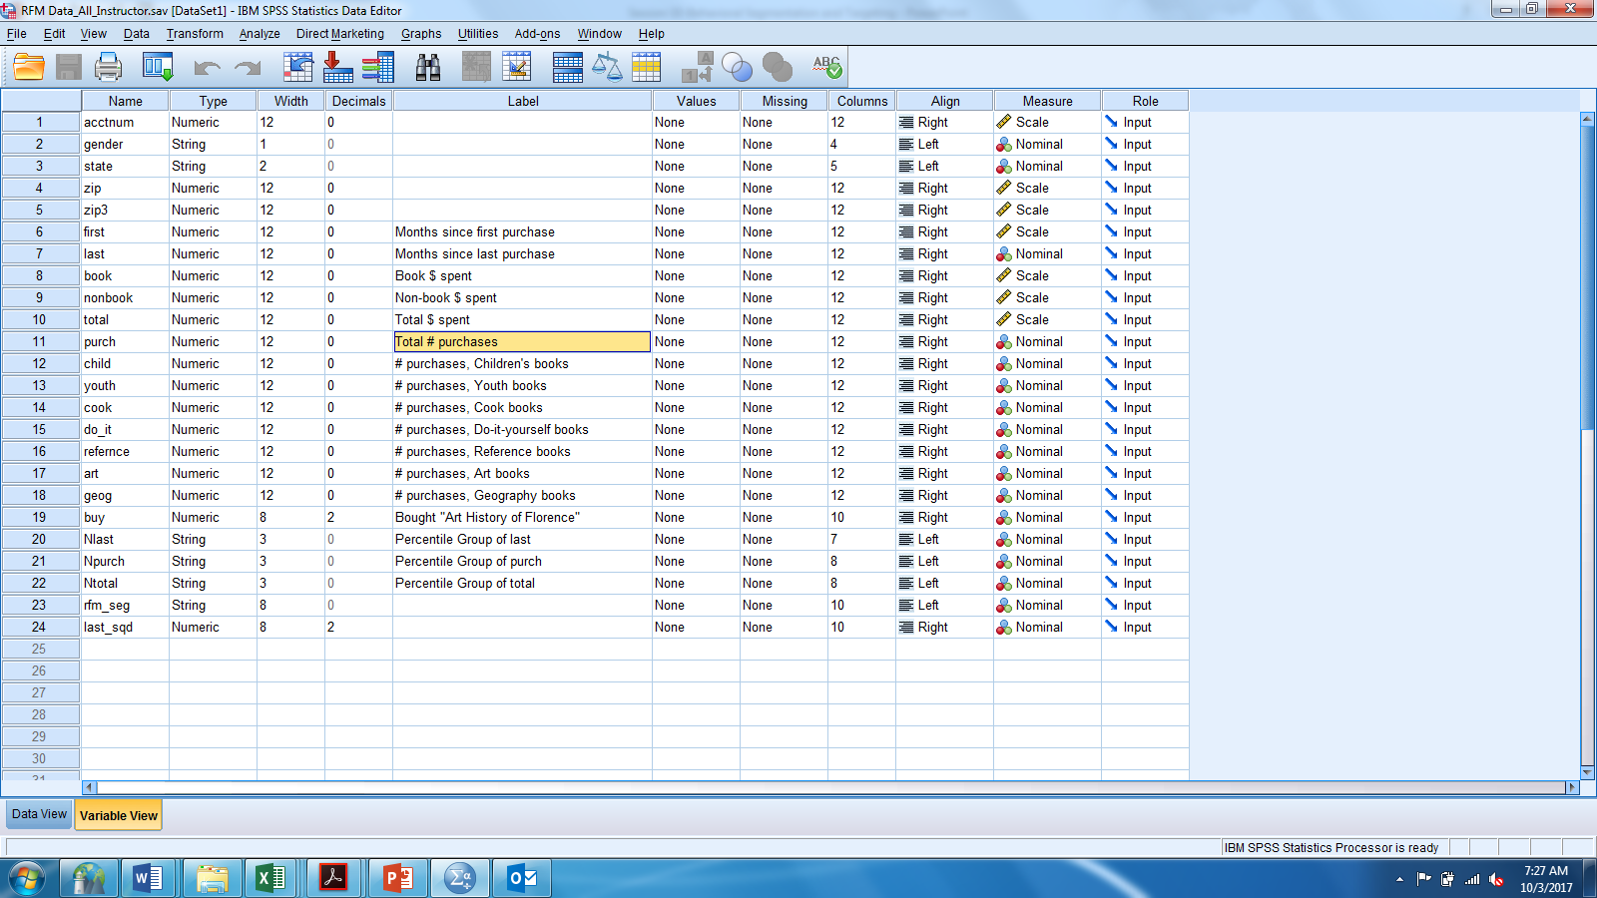
SEGMENTATION
Sales Data Come in All Shapes and Sizes!
Imagine a median split on last (months since last purchase), total (total $ spent) and purch (total # of purchases in last 12 months)
Each customer scored as above (1) or below (2) median on each of the three variables

Slide 7
SEGMENTATION
Sales Data Come in All Shapes and Sizes!
Imagine a median split on last (months since last purchase), total (total $ spent) and purch (total # of purchases in last 12 months)
Each customer scored as above (1) or below (2) median on each of the three variables
Each customer falls into 1 of 8 possible segments

Slide 8
SEGMENTATION
Sales Data Come in All Shapes and Sizes!
We can refine the segmentation by creating smaller bins than simply a median split
How many bins you choose is a function of your total sample size
You want to have sufficient sample size in each segment

Slide 9
SEGMENTATION
What have the customers done?
How to Form Behavioral Segments Based on RFM
Start with Recency
Sort database from best to worst on variable
Divide into N groups (N=5, quintiles)
– Top group is quintile 1, second is quintile 2, etc.
– Doesn't matter whether top is 1 or 5, as long as consistent across variables.
Repeat Process with Frequency
Repeat Process with Monetary Value
8
Notes:
8

Slide 10
SEGMENTATION
What have the customers done?
SORT 1
SORT 2
SORT 3
RECENCY DATA
RECENCY SORT
FREQUENCY DATA
FREQUENCY SORT
MONETARY DATA
MONETARY SORT
9
Notes:
9
So the research question here is
whether (and how) demand uncertainty impacts consumer choice between three-part tariffs (DEMAND = USAGE)
And what the effect of this demand uncertainty is on consumer surplus and provider revenue UNDER THREE-PART TARIFFS
Even though there is a lot of plans like this it is turns out, that this is not well studied
You might ask – well, why is this relevant, why care about it
First, understanding consumer behavior helps firms to set prices (potentially also segment along usage uncertainty, not only usage level)
Regulators to monitor firms’ pricing behavior
Researchers to understand why three-part tariffs are so common
I will now set out to
First, give an intuitive explanation
Then, introduce my data and a model
Last, show empirical results that show the role of uncertainty

Slide 11
SEGMENTATION
What have the customers done?
Example of RFM Segmentation of Customer Database
Once you have RFM segments defined you can count the number of customers in each segment
You can also summarize marketing response by segment

Slide 12
FROM SEGMENTATION TO TARGETING
A Marketing Field Experiment
Direct mail book retailer is considering 50,000 customers for a new book offer
The marketing director decides to run a test
The director pulls a random sample of ~10% of customers and offers book deal to the sample. There are 4,936 in the sample.
We observe response to the offer
We observe the R, F, and M quintile for each respondent for the 4,936 test consumers and the remaining 45,064 customers
The director must decide on how many of the 45,064 customers in the rollout set should receive the offer?
Data in Session 10 Folder of Canvas
11
Notes:
11

Slide 13
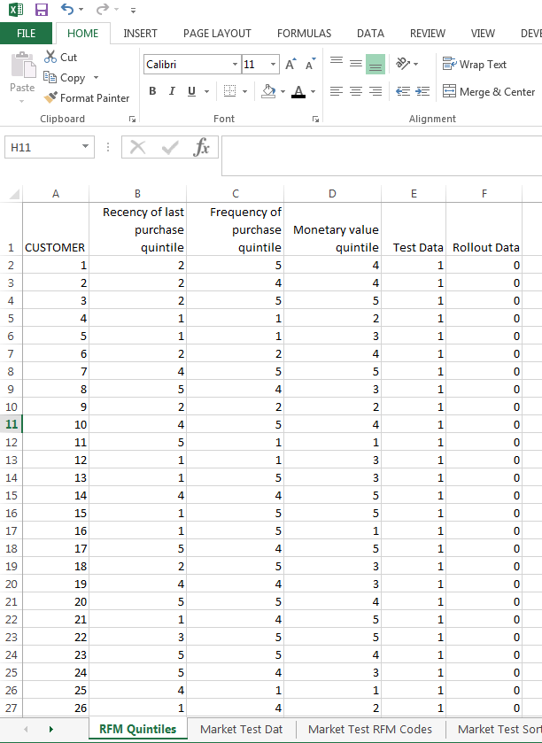
SEGMENTATION
What have the customers done?

Slide 14
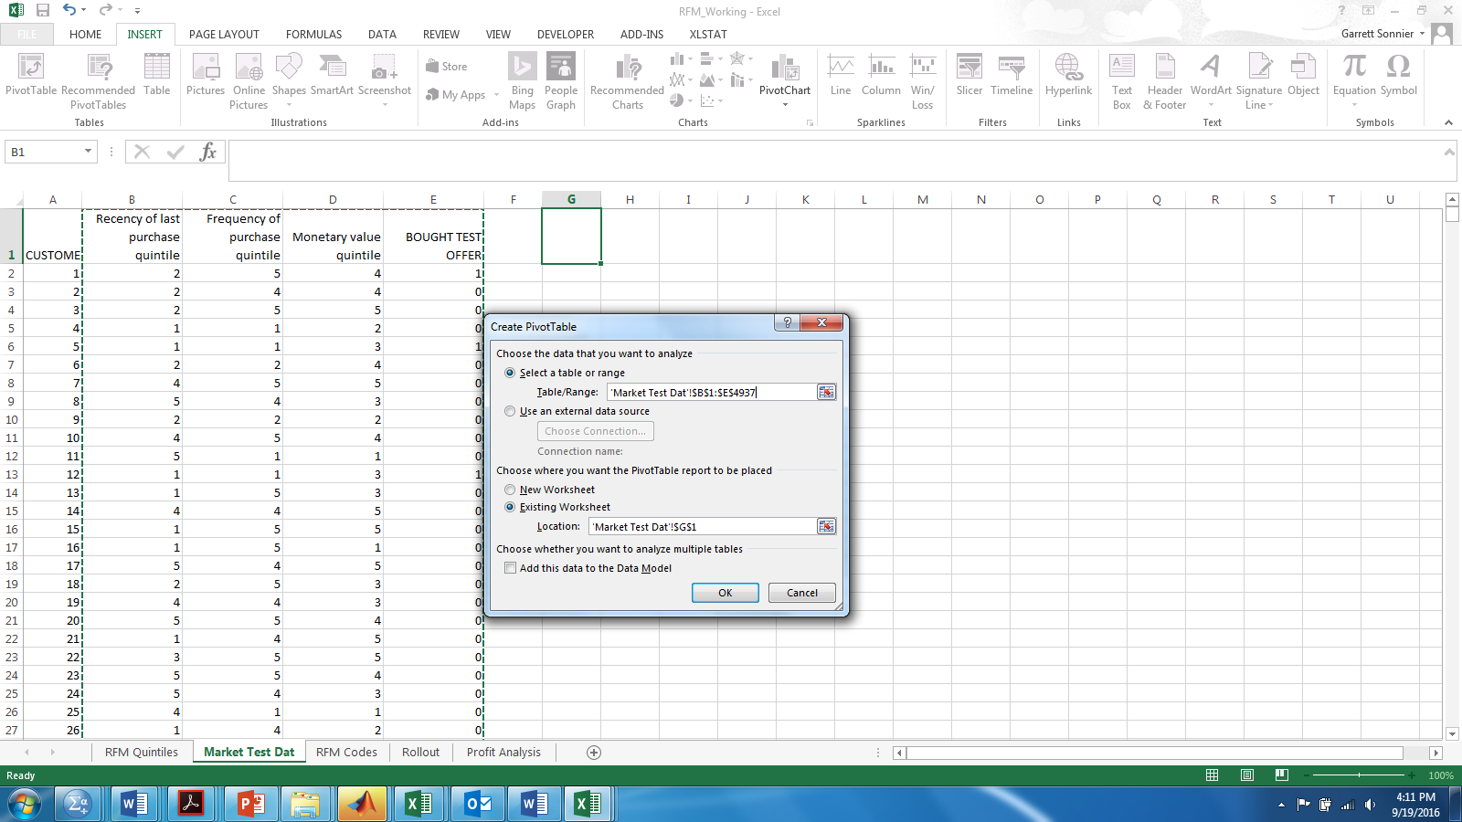
SEGMENTATION
What is the Overall Response Rate?
Data from “Market Test Dat” tab in Workbook

Slide 15
SEGMENTATION
What is the Overall Response Rate?
Data from “Market Test Dat” tab in Workbook

Slide 16
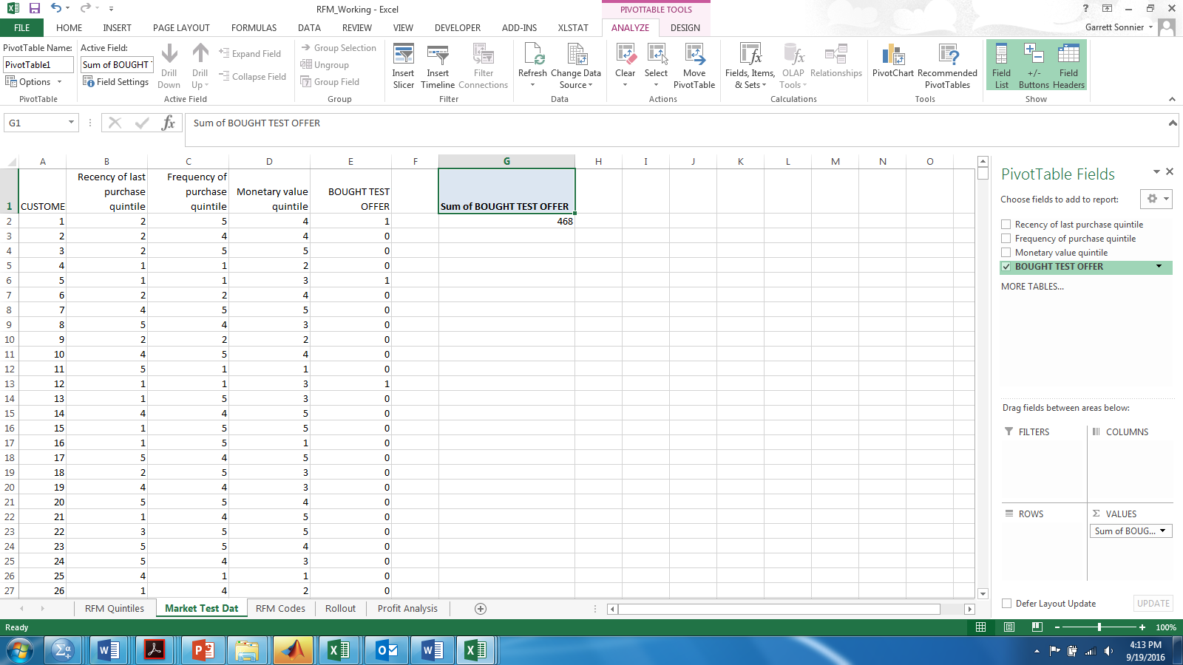
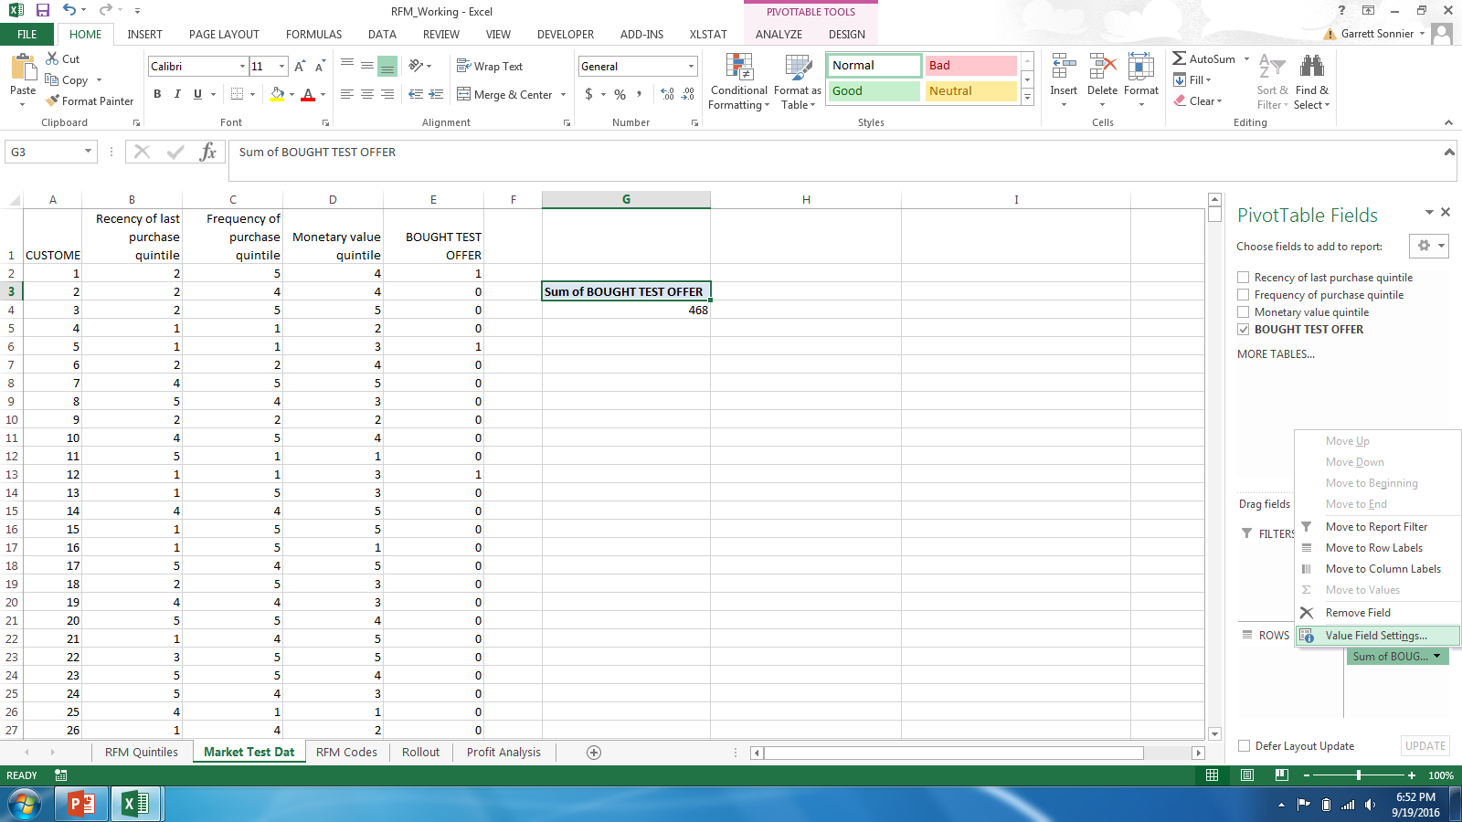
SEGMENTATION
What is the Overall Response Rate?
Data from “Market Test Dat” tab in Workbook

Slide 17
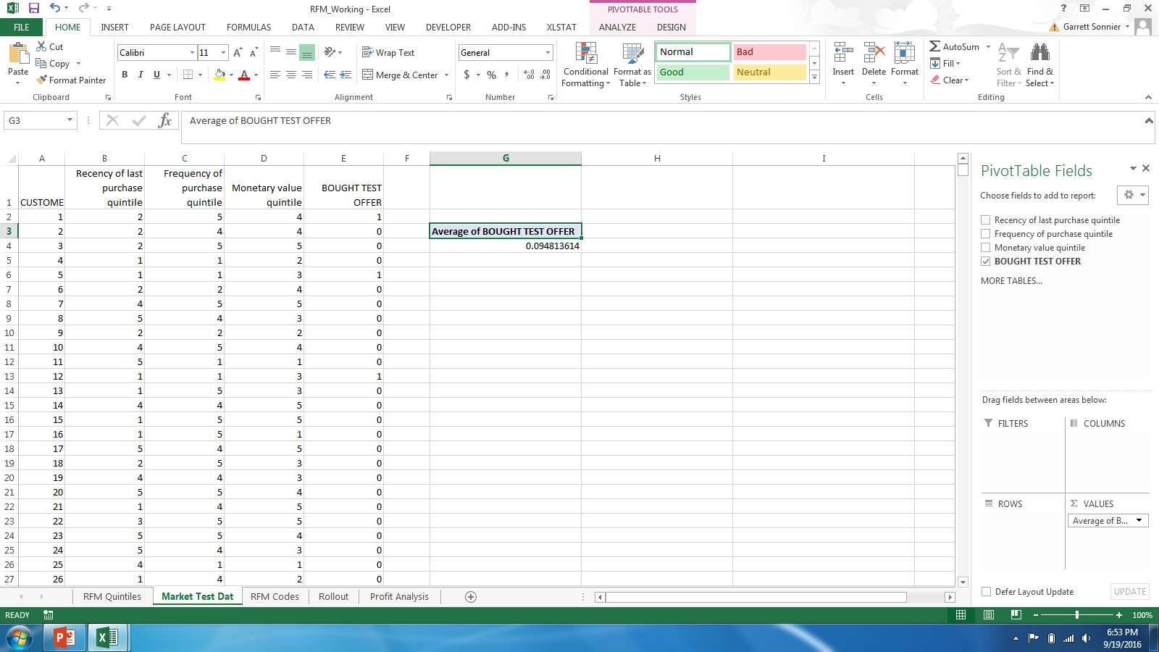
SEGMENTATION
What is the Overall Response Rate?
Data from “Market Test Dat” tab in Workbook
Is there a relation between response to test offer and recency?

Slide 18
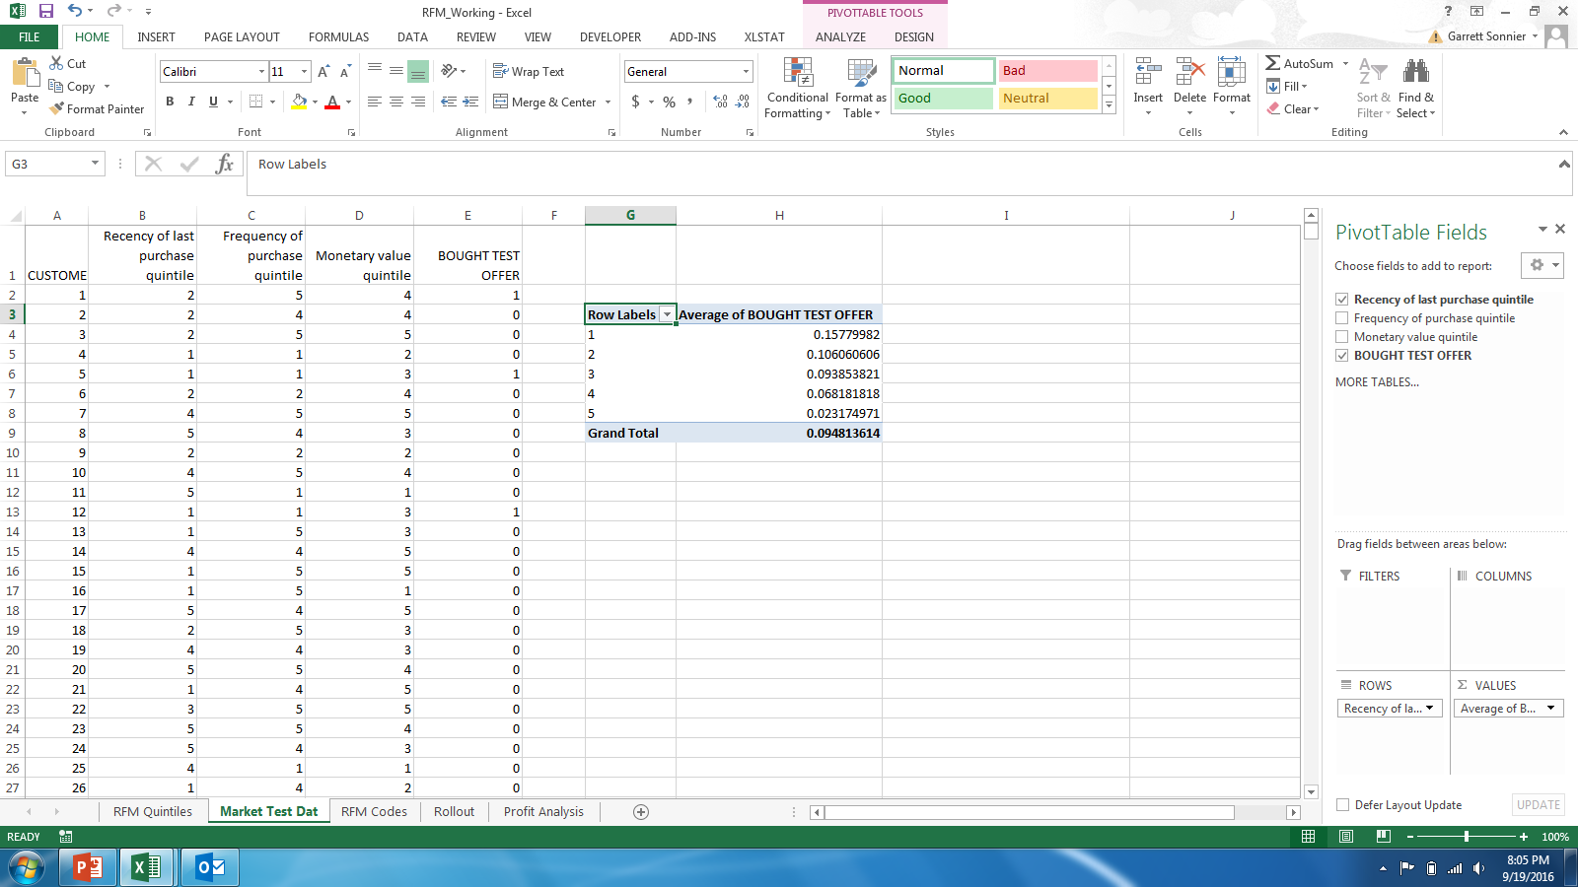
SEGMENTATION
Relationship Between Recency and Response
Data from “Market Test Dat” tab in Workbook

Slide 19
SEGMENTATION
Relationship Between Recency and Response

Slide 20
SEGMENTATION
Relationship Between Frequency and Response

Slide 21
SEGMENTATION
Relationship Between Monetary Value and Response

Slide 22
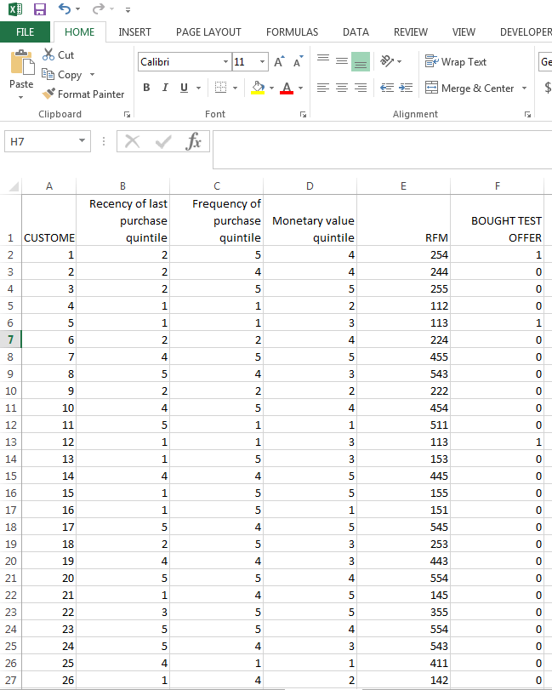
SEGMENTATION
Recency, Frequency, and Monetary Value
Data from “Market Test RFM Codes” tab in Workbook
Create a 3 Digit RFM code
100*Recency + 10*Frequency + 1*Monetary
These are my segments!

Slide 23
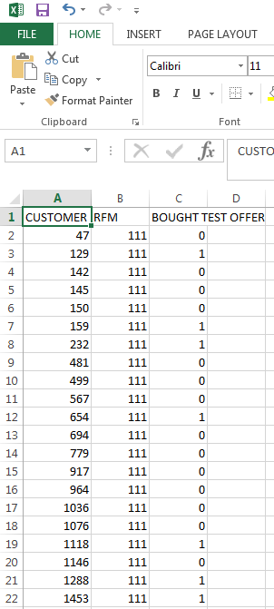
SEGMENTATION
Recency, Frequency, and Monetary Value
Data from “Test Data Sorted by RFM” tab in Workbook
Customer, RFM Code and Bought Test Offer variables copied into new sheet
Data sorted by RFM code
Compute cell size and buy rate for each RFM code

Slide 24
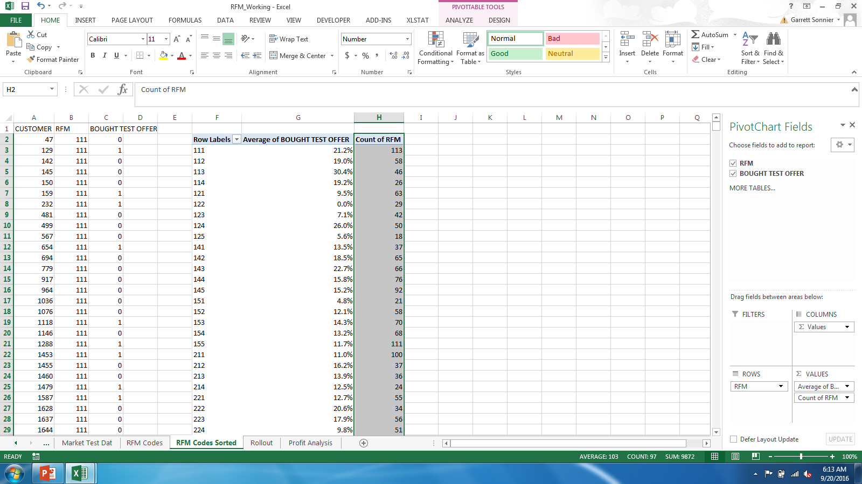
SEGMENTATION
Recency, Frequency, and Monetary Value
Data from “Test Data Sorted by RFM” tab in Workbook
Plot the response rate against the RFM codes

Slide 25
SEGMENTATION
Is Past Behavior Related to Response?
24
Notes:
24
So the research question here is
whether (and how) demand uncertainty impacts consumer choice between three-part tariffs (DEMAND = USAGE)
And what the effect of this demand uncertainty is on consumer surplus and provider revenue UNDER THREE-PART TARIFFS
Even though there is a lot of plans like this it is turns out, that this is not well studied
You might ask – well, why is this relevant, why care about it
First, understanding consumer behavior helps firms to set prices (potentially also segment along usage uncertainty, not only usage level)
Regulators to monitor firms’ pricing behavior
Researchers to understand why three-part tariffs are so common
I will now set out to
First, give an intuitive explanation
Then, introduce my data and a model
Last, show empirical results that show the role of uncertainty

Slide 26
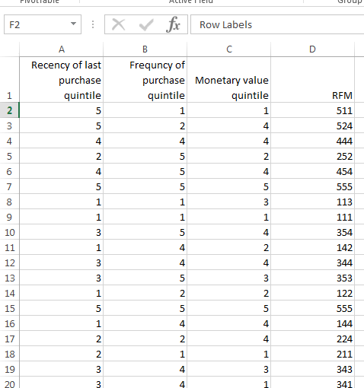
FROM SEGMENTATION TO TARGETING
To Whom Should We Extend the Offer?
Data from “Rollout Data” tab in Workbook
How many rollout customers are in each RFM segment?

Slide 27


FROM SEGMENTATION TO TARGETING
To Whom Should We Extend the Offer?
Data from “Rollout” tab in Workbook
I know how many rollout customers are in each cell
I do not know the buy rate
How can I approximate it?

Slide 28
FROM SEGMENTATION TO TARGETING
To Whom Should We Extend the Offer?
Data from “Test Data Sorted by RFM” tab in Workbook
Go back to the RFM cell response rates from the test data
Match test data and rollout data on RFM code
Use response rate from test data as estimate of response rate in rollout data

Slide 29
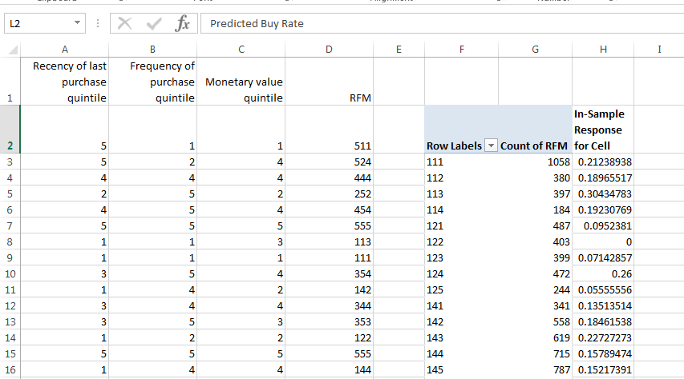
FROM SEGMENTATION TO TARGETING
Estimating Response Rate in Rollout Data
Matched on RFM Cell from Market Test Data
Data from “Rollout” tab in Workbook
What is the expected number of buyers among the 45,064 rollout customers?

Slide 30
FROM SEGMENTATION TO TARGETING
To Whom Should We Extend the Offer?
Total No. of Customers: 45,064
Total Expected No. of Buyers: 4,182
Expected Total Buy Rate: 9.28%
Thought Experiment
Take all customers and randomly divide into 10 groups of equal size
How many buyers would you expect to find in each group?

Slide 31
FROM SEGMENTATION TO TARGETING
Random Selection Expected Sales
Are there gains to targeting?

Slide 32
FROM SEGMENTATION TO TARGETING
No Targeting

Slide 33
FROM SEGMENTATION TO TARGETING
To Whom Should We Extend the Offer?
Are there gains to targeting?
First sort the data by the response rate

Slide 34
FROM SEGMENTATION TO TARGETING
To Whom Should We Extend the Offer?
Are there gains to targeting?
Total No. of Customers: 45,064
Total Expected No. of Buyers: 4,182

Slide 35
FROM SEGMENTATION TO TARGETING
No Targeting

Slide 36
FROM SEGMENTATION TO TARGETING
Marketing Economics
Cost and Price Information
– Cost of Making the Offer $0.50
– Selling price (including shipping) paid by customer $18.00
– Wholesale price is $9.00
– Shipping costs $3.00
Think about offering to 100 people
How many need to respond to break even on investment?
Break-even response: $50/($18-$9-$3) = 8.3 responses (8.3%)
For the rollout: target customers in RFM cells with a response rate that is greater than or equal to the breakeven response rate
35
Notes:
35

Slide 37
FROM SEGMENTATION TO TARGETING
Select targeted cells and extend the offer to them
Estimate of RFM Cell Response Rate
# of Customers in Rollout by Cell
x
Expected Cell Response Rate
…
Cut Off
By mailing to only ~50% of the customers we get 78% of the sales!
…

Slide 38
FROM SEGMENTATION TO TARGETING
Expected Profitability: Final Analysis

Slide 39
FROM SEGMENTATION TO TARGETING
Random Selection and Profitability
Revenues are Expected Sales x $18
Costs are Expected Sales x $12 plus # of Customers x $0.50

Slide 40
FROM SEGMENTATION TO TARGETING
RFM Selection and Profitability
Revenues are Expected Sales x $18
Costs are Expected Sales x $12 plus # of Customers x $0.50

Slide 41
FROM SEGMENTATION TO TARGETING
RFM Selection and Profitability

Slide 42
FROM SEGMENTATION TO TARGETING
Expected vs. Actual Profitability

Slide 43
FROM SEGMENTATION TO TARGETING
Estimating Response Rate in Rollout Data
Matched on RFM Cell from Market Test Data
Data from “Rollout” tab in Workbook
~45,000 rollout customers assigned to one of ~125 segments
Each segment has a response rate computed from test data as the % of buyers in the cell
With solicitation costs of $0.50 and a $6 margin the B/E response rate is 8.3%

Slide 44
FROM SEGMENTATION TO TARGETING
Expected vs. Actual Profitability
Thoughts?
Limits?
Ways to improve?

Slide 45
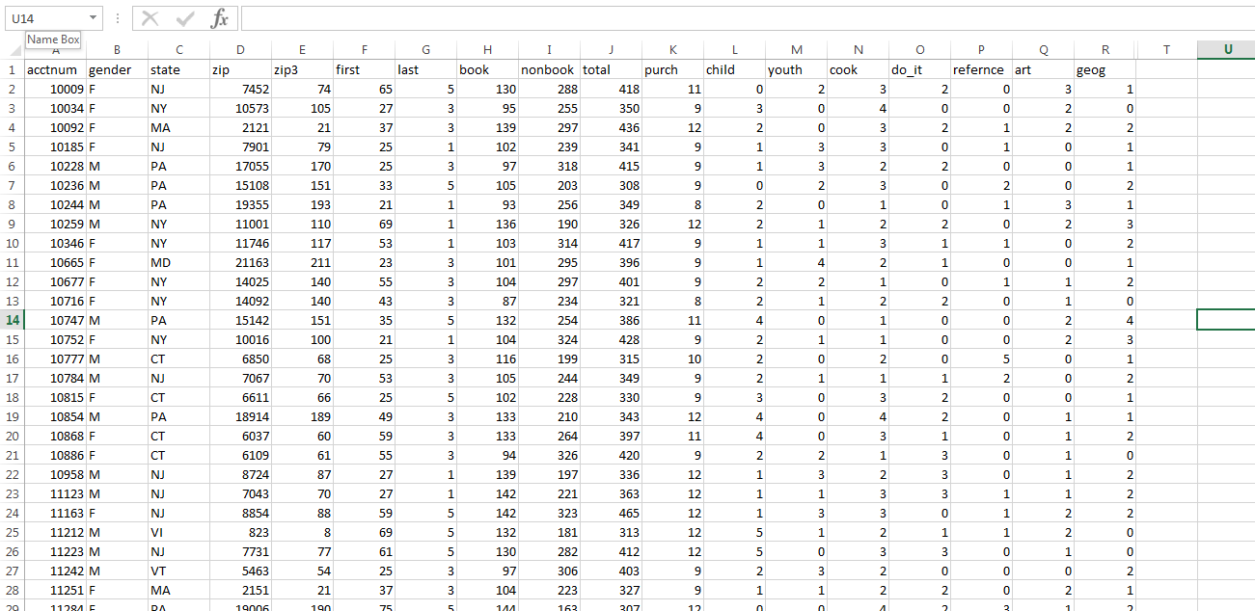
FROM SEGMENTATION TO TARGETING
Can We Improve Over RFM Strategy?
Snapshot of the ~45,000 rollout observations
Thru RFM these are grouped into ~125 segments each of which has an estimated response rate
I would like each individual observation to have an estimated response rate (i.e., and individual level estimate of the probability of buying)
Let’s go back to the market test data

Slide 46
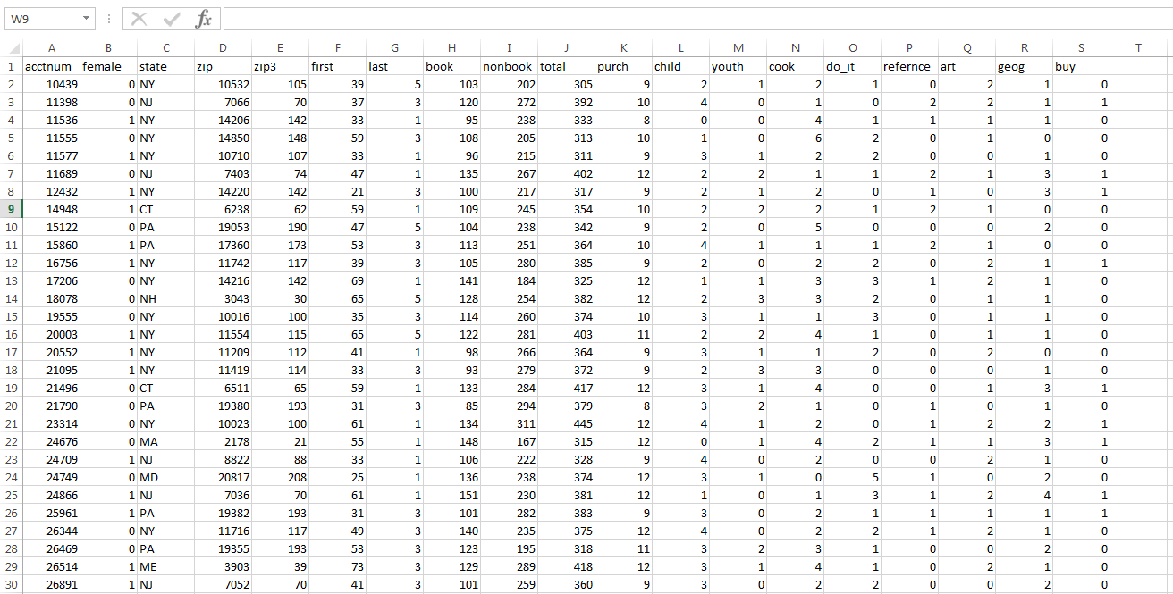
FROM SEGMENTATION TO TARGETING
Can We Improve Over RFM Strategy?
We need a model to predict “buy” in column S (i.e. buy is our y variable)
Sticking with “last”, “total”, and “purch” (i.e., RFM variables) as our X variables, I’d like to translate these into a score and then translate the score into a probability

Slide 47
FROM SEGMENTATION TO TARGETING
A Useful Transformation
Let s be any normally distributed random variable with some mean and variance
Example: s~N(1,1)
The logit transformation will produce a new variable that lies between 0-1 and hence can be interpreted as a probability

Slide 48
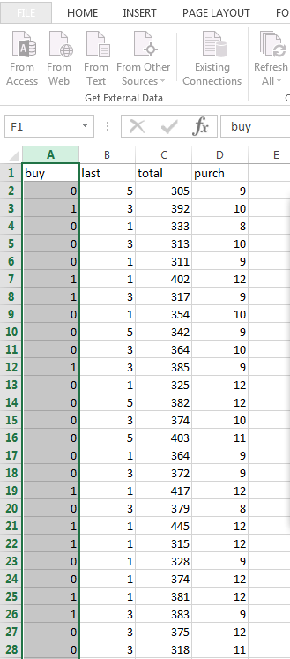
FROM SEGMENTATION TO TARGETING
When Is This Useful?
When dependent variable (DV) is discrete
Generally: Response vs. No-response (Binary Logit!)
Decision rule
We want an estimate of the probability of buying
We need a model for the score
We need a way to transform the score into a probability
Notes:
So the research question here is
whether (and how) demand uncertainty impacts consumer choice between three-part tariffs (DEMAND = USAGE)
And what the effect of this demand uncertainty is on consumer surplus and provider revenue UNDER THREE-PART TARIFFS
Even though there is a lot of plans like this it is turns out, that this is not well studied
You might ask – well, why is this relevant, why care about it
First, understanding consumer behavior helps firms to set prices (potentially also segment along usage uncertainty, not only usage level)
Regulators to monitor firms’ pricing behavior
Researchers to understand why three-part tariffs are so common
I will now set out to
First, give an intuitive explanation
Then, introduce my data and a model
Last, show empirical results that show the role of uncertainty

Slide 49
FROM SEGMENTATION TO TARGETING
When Is This Useful?
When dependent variable (DV) is discrete
Generally: Response vs. No-response (Binary Logit!)
We want an estimate of the probability of buying
We need a model for the score
We need a way to transform the score into a probability
Notes:
So the research question here is
whether (and how) demand uncertainty impacts consumer choice between three-part tariffs (DEMAND = USAGE)
And what the effect of this demand uncertainty is on consumer surplus and provider revenue UNDER THREE-PART TARIFFS
Even though there is a lot of plans like this it is turns out, that this is not well studied
You might ask – well, why is this relevant, why care about it
First, understanding consumer behavior helps firms to set prices (potentially also segment along usage uncertainty, not only usage level)
Regulators to monitor firms’ pricing behavior
Researchers to understand why three-part tariffs are so common
I will now set out to
First, give an intuitive explanation
Then, introduce my data and a model
Last, show empirical results that show the role of uncertainty

Slide 50
FROM SEGMENTATION TO TARGETING
When Is This Useful?
When dependent variable (DV) is discrete
Generally: Response vs. No-response (Binary Logit!)
Steps to follow
Estimate beta with binary logistic regression
Use beta to estimate score
Use score to compute probability
With values of last, total, and purch in the rollout sample we can estimate score and probability for every single rollout customer
Notes:
So the research question here is
whether (and how) demand uncertainty impacts consumer choice between three-part tariffs (DEMAND = USAGE)
And what the effect of this demand uncertainty is on consumer surplus and provider revenue UNDER THREE-PART TARIFFS
Even though there is a lot of plans like this it is turns out, that this is not well studied
You might ask – well, why is this relevant, why care about it
First, understanding consumer behavior helps firms to set prices (potentially also segment along usage uncertainty, not only usage level)
Regulators to monitor firms’ pricing behavior
Researchers to understand why three-part tariffs are so common
I will now set out to
First, give an intuitive explanation
Then, introduce my data and a model
Last, show empirical results that show the role of uncertainty

Slide 51
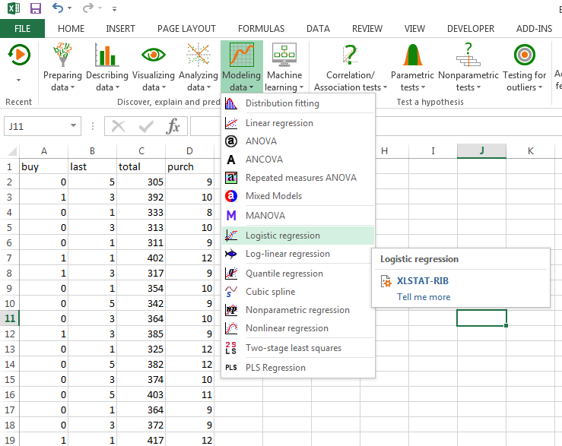
FROM SEGMENTATION TO TARGETING
Binary Logistic Regression in XLSTAT

Slide 52
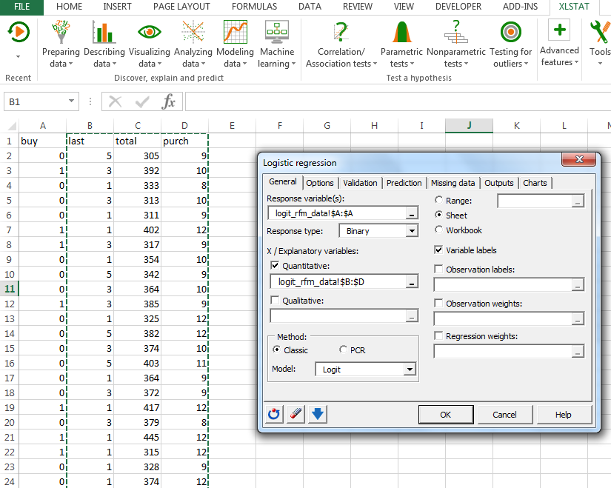
FROM SEGMENTATION TO TARGETING
Binary Logistic Regression in XLSTAT

Slide 53
FROM SEGMENTATION TO TARGETING
Binary Logistic Regression in XLSTAT
Given a value for last, total and purch we can generate an estimated score and an estimated probability

Slide 54
FROM SEGMENTATION TO TARGETING
Using the Model
Snapshot of the ~45,000 rollout observations
For every customer I know their value of last, total and purch
I can use my model to predict their score
Using the score and the logit transformation I can compute the probability that they would buy

Slide 55
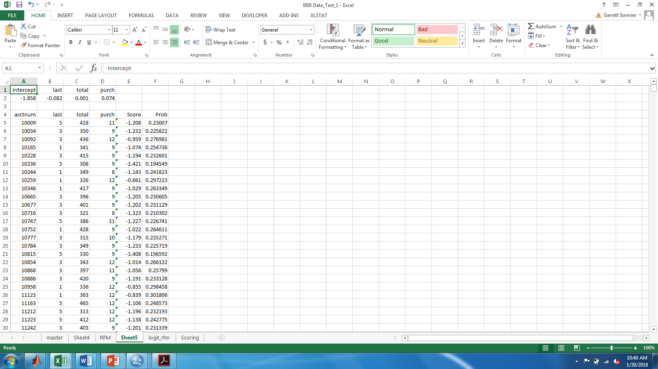
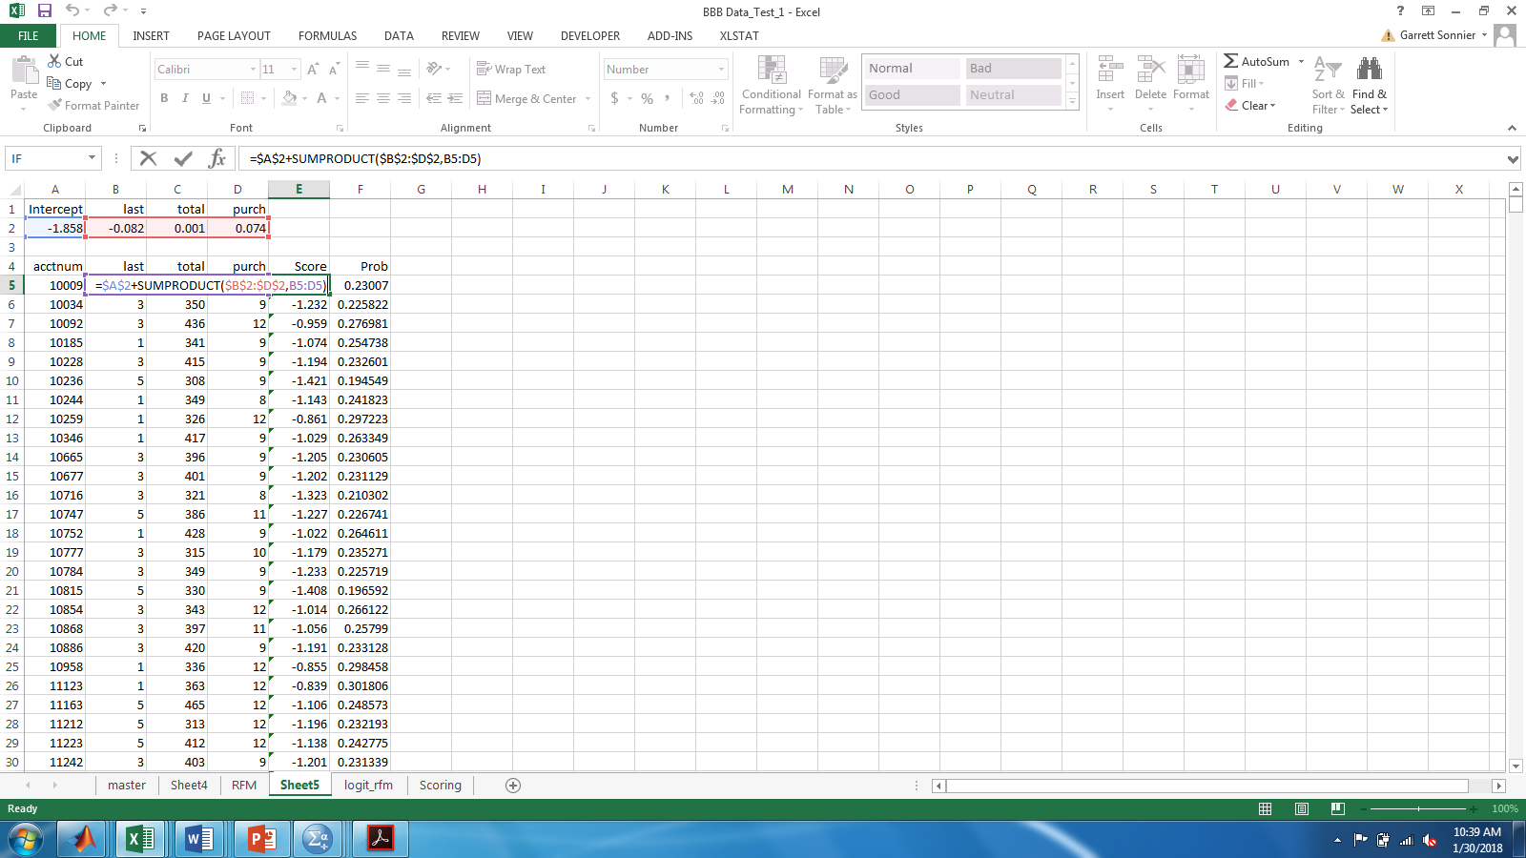
FROM SEGMENTATION TO TARGETING
Using the Model
First we compute the score

Slide 56
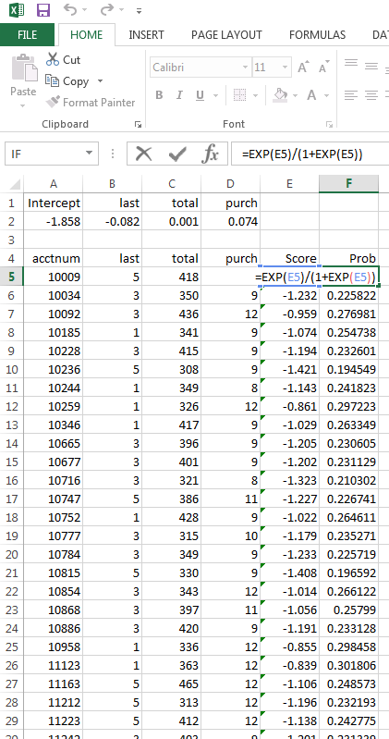
FROM SEGMENTATION TO TARGETING
Using the Model
Using the score we compute the probability

Slide 57
FROM SEGMENTATION TO TARGETING
Using the Model
How did we do?
Target top 6 households and expect to sell about 2 books (just summing probabilities)
Actually sold 3 books
Total # of expected sales would be sum of probabilities among targeted customers

Slide 58
FROM SEGMENTATION TO TARGETING
Model vs. Heuristic
Propensity Score Approach
RFM Approach

Slide 59
TARGETING BASED ON RFM ANALYSIS
Key Concepts from Today
RFM uses rules of thumb derived from past purchase behavior to predict market response
Does not require sophisticated software or analytics
RFM is limited to R, F, M:
• There may be more predictive information
No clear way to incorporate other information
Propensity scoring models allow us to incorporate other information

